Slide 1
DisplayPort 1.4 Switch 3-in-1-out
SKU: DP-113-GL

Slide 2
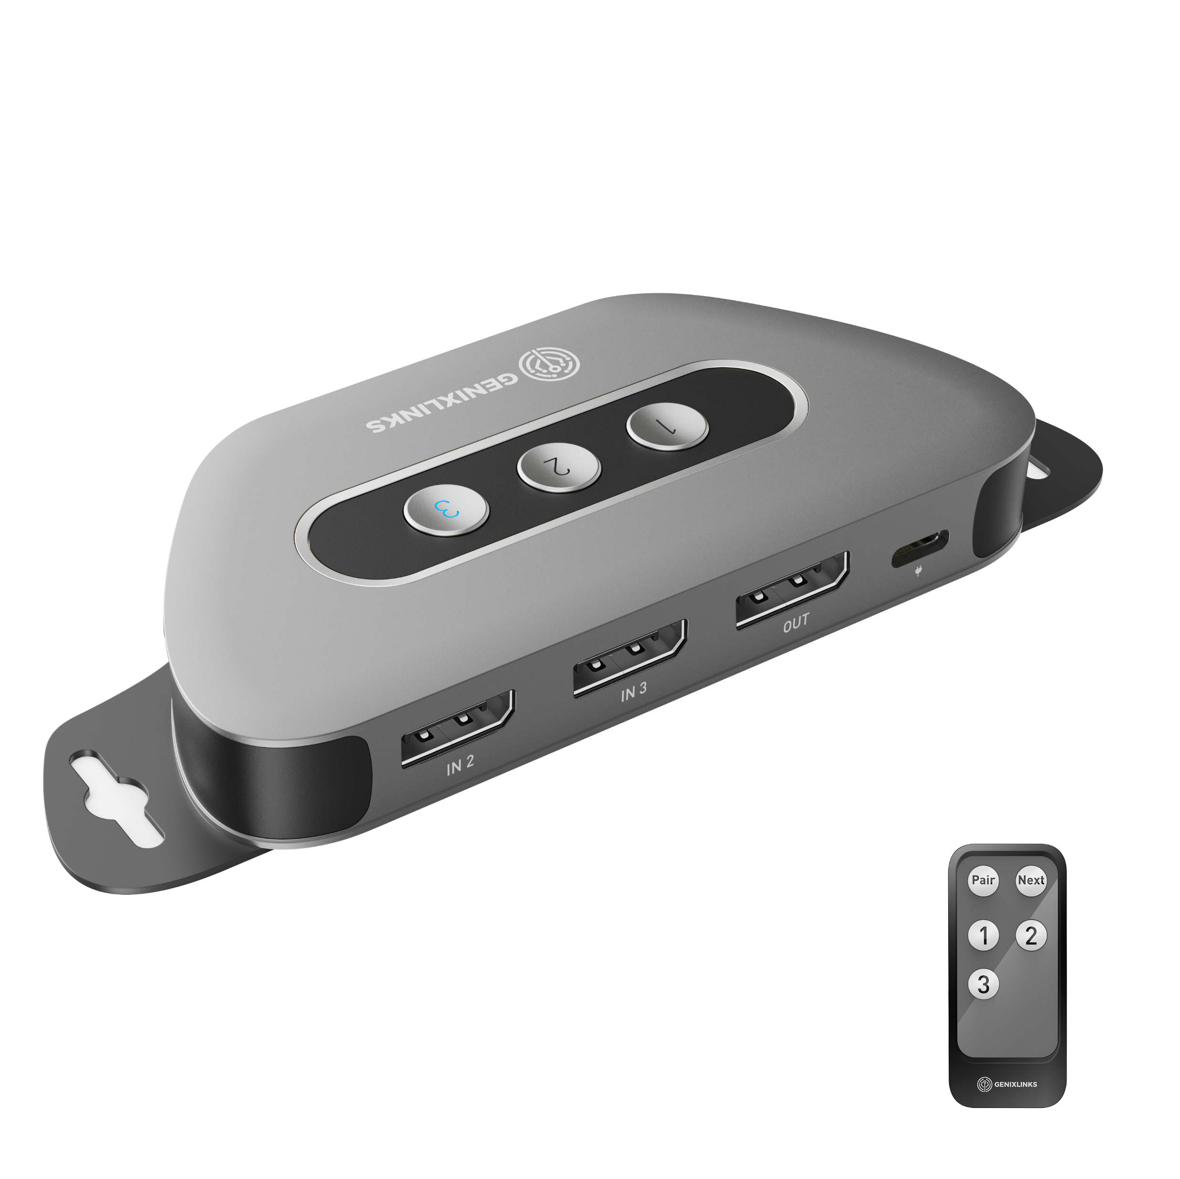
DisplayPort 1.4 Switch,
3-in-1-out

Slide 3
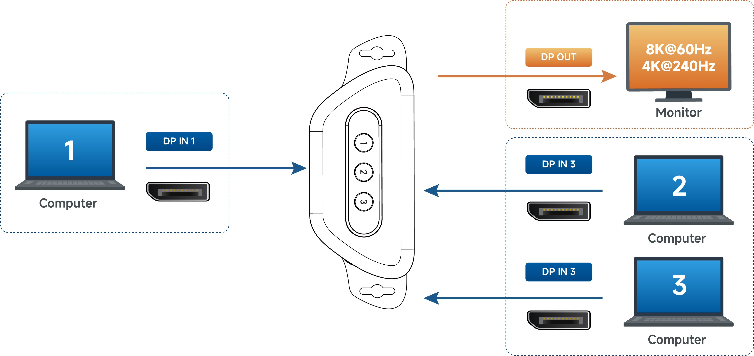
Application Scenario

Slide 4
Specification
Connectors | Input | 3x DisplayPort Female
 | Output | 1x DisplayPort Female
 | Power Port | USB-C Female
Compatibility | OS Support | Windows10 or later，MacOS12 or later，LinuxOS
Performance | Display Support | Up to 8K@60Hz or 4K@240Hz
 | Audio Support | DTS ,uncompressed digital 7.1, 5.1 or 2ch
 | Function Support | VRR，HDCP2.2，HDR
Physical Characteristics | Dimension | 4.4 x 2.2 x 0.6 in. (112.2 x 55 x 16mm)
 | Material | Metal and ABS Housing
Packaging Information | Accessories | 2x 6 ft DP 1.4 Cables, 1x 6 ft USB-A to USB-C Charging Cable, 1x Remote Control, 2x Mounting Brackets & Screws
Certification | FCC/CE/RoHS
Country of Origin | Thailand

Slide 5
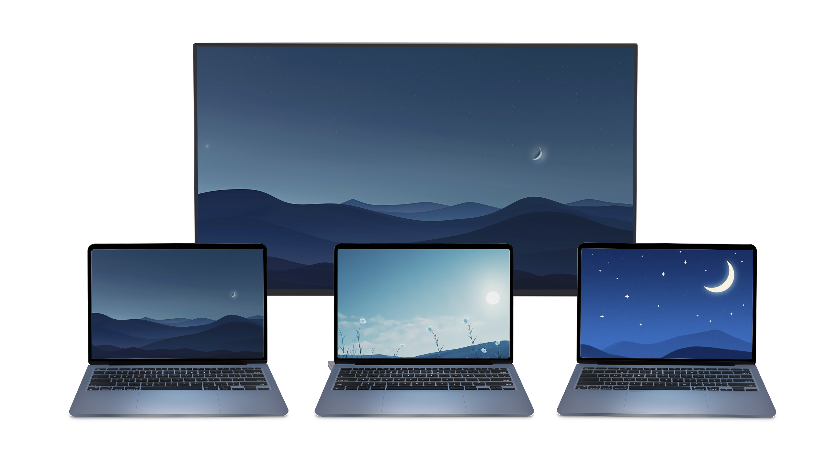
Specification
Resolution | DP Cable Length (for IN port) | DP Cable Length (for OUT port) | DP Cable Length(Total) | AWG
8K@60Hz | ≤13ft | ≤13ft | ≤26ft | 28AWG(DP1.4)
4K@240Hz | ≤13ft | ≤13ft | ≤26ft | 28AWG(DP1.4)
4K@144Hz | ≤16ft | ≤16ft | ≤32ft | 28AWG(DP1.4)
4K@60Hz | ≤20ft | ≤20ft | ≤40ft | 28AWG(DP1.2)
1080p@60Hz | ≤25ft | ≤25ft | ≤50ft | 28AWG(DP1.2)

Slide 6
Thanks!

