Slide 1
Active 8K HDMI Repeater
SKU: HDMI-394-GL

Slide 2
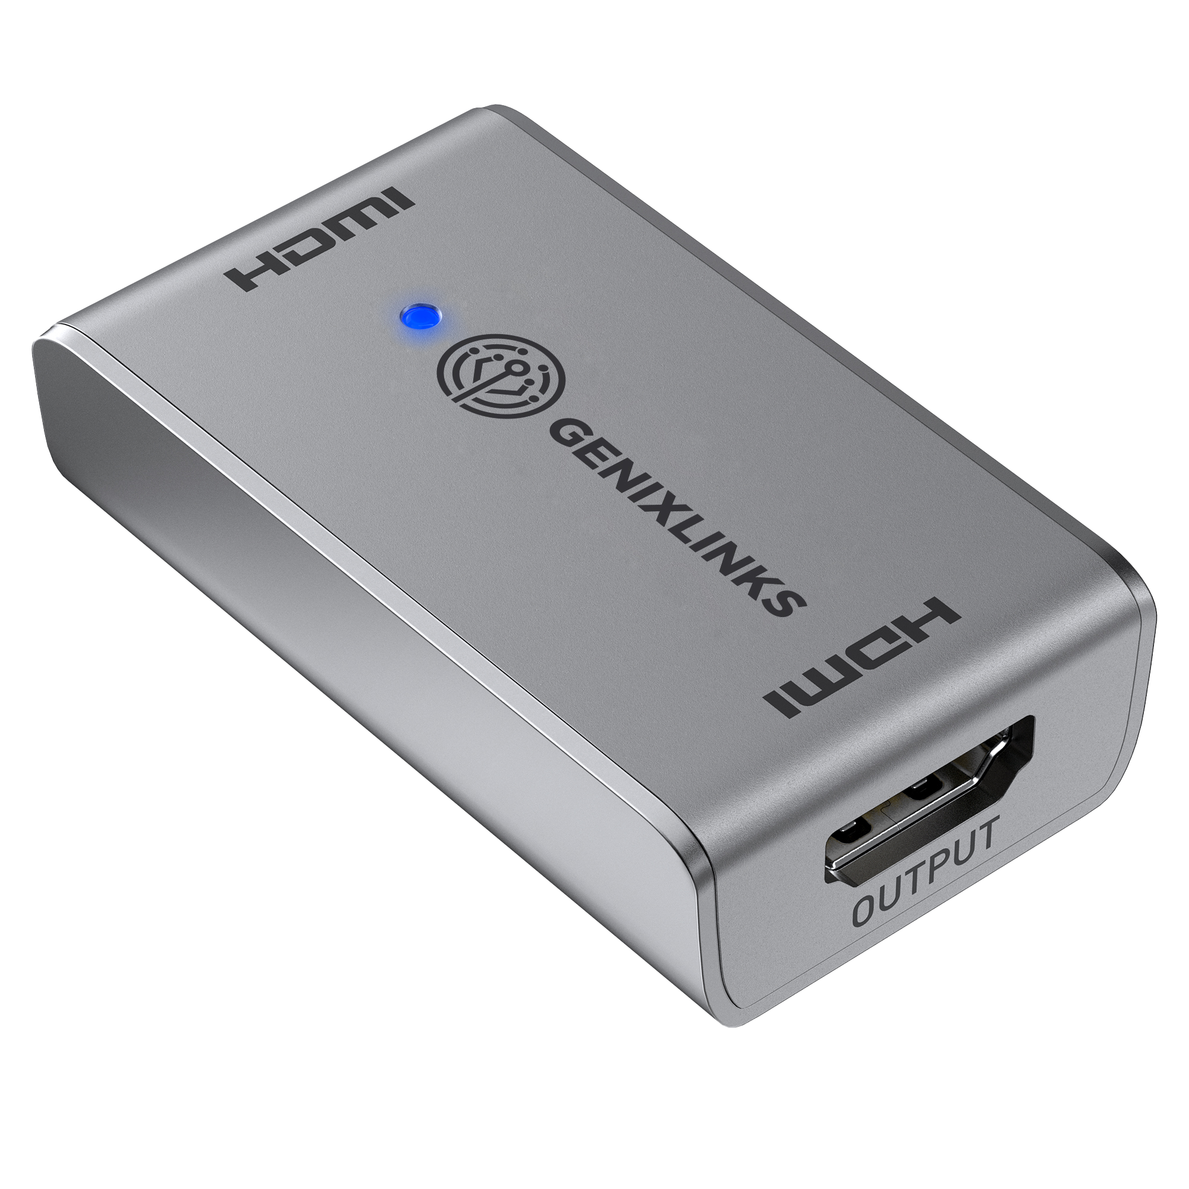
Active 8K HDMI Repeater

Slide 3
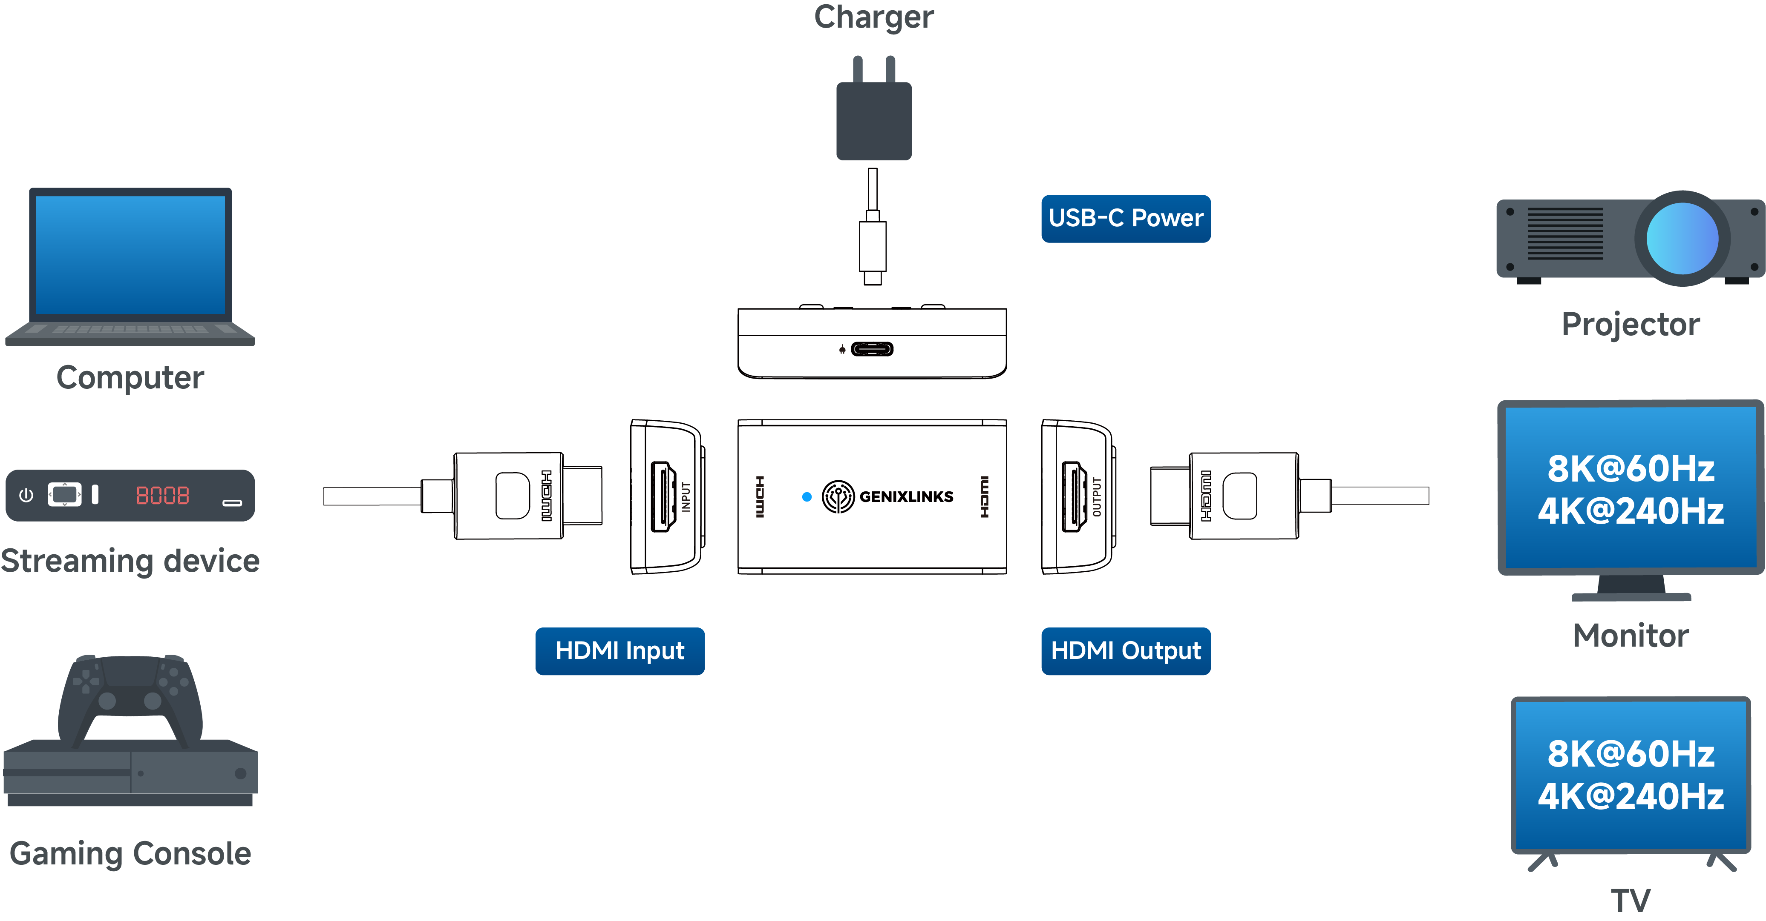
Application Scenario
（Optional）

Slide 4
Specification
Connectors | Input | 1x HDMI Female
 | Output | 1x HDMI Female
 | Power Port | USB-C Female
Compatibility | OS Support | OS Independent
Performance | Display Support | Up to 8K@60Hz or 4K@240Hz
 | Audio Support | 32 Channel LPCM, Compressed Audio
 | Power | 5V/1A (Optional)
Physical Characteristics | Dimension | 2.4 x 1.4 x 0.6 in. (62 x 35.8 x 14.5mm)
 | Material | Metal Housing
 | Color | Gray
Indicators | LED Indicators | Power Indicator (Blue)
Certification | FCC/CE/RoHS/HDMI
Country of Origin | Thailand

Slide 5
Maximum Supported Cable Lengths
HDMI Version | Resolution / Refresh Rate | IN (Max Input Length) | OUT (Max Output Length) | Total Length (IN+OUT)
HDMI 2.1 | 8K@60Hz / 4K@240Hz / 4K@120Hz | 13.1ft (4m) | 16.4ft (5m) | 29.5ft (9m)
HDMI 2.0 | 4K@60Hz | 25ft (7.5m) | 25ft (7.5m) | 50ft (15m)

Slide 6
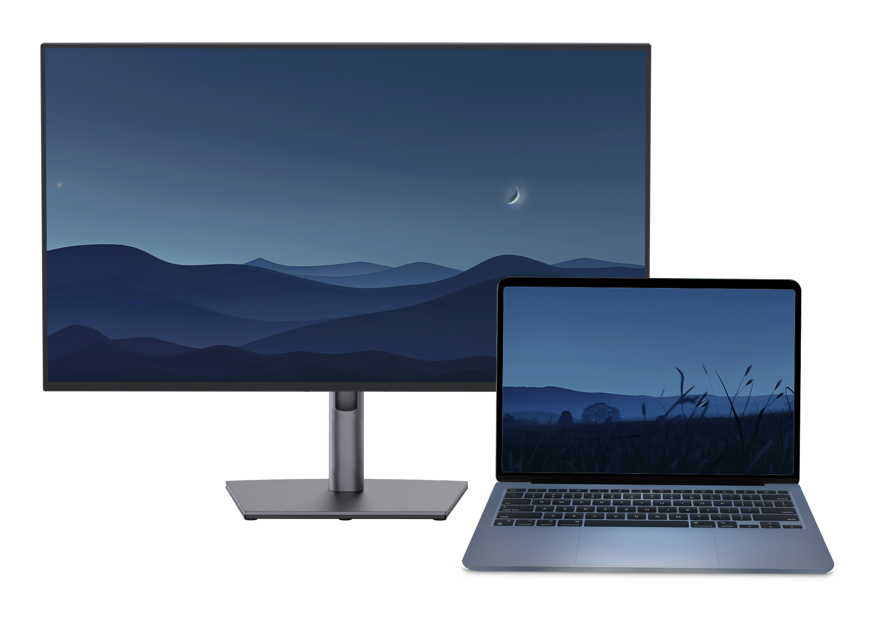
Max Display Resolution – Windows / Chromebooks
Windows / Chromebook Host | Maximum Resolution
USB-C Alternate Mode HBR3 with DSC Enabled | 7680 x 4320 @60Hz, 3840 x 2160 @240Hz
USB-C Alternate Mode HBR2/HBR3 | 3840 x 2160 @60Hz

Slide 7
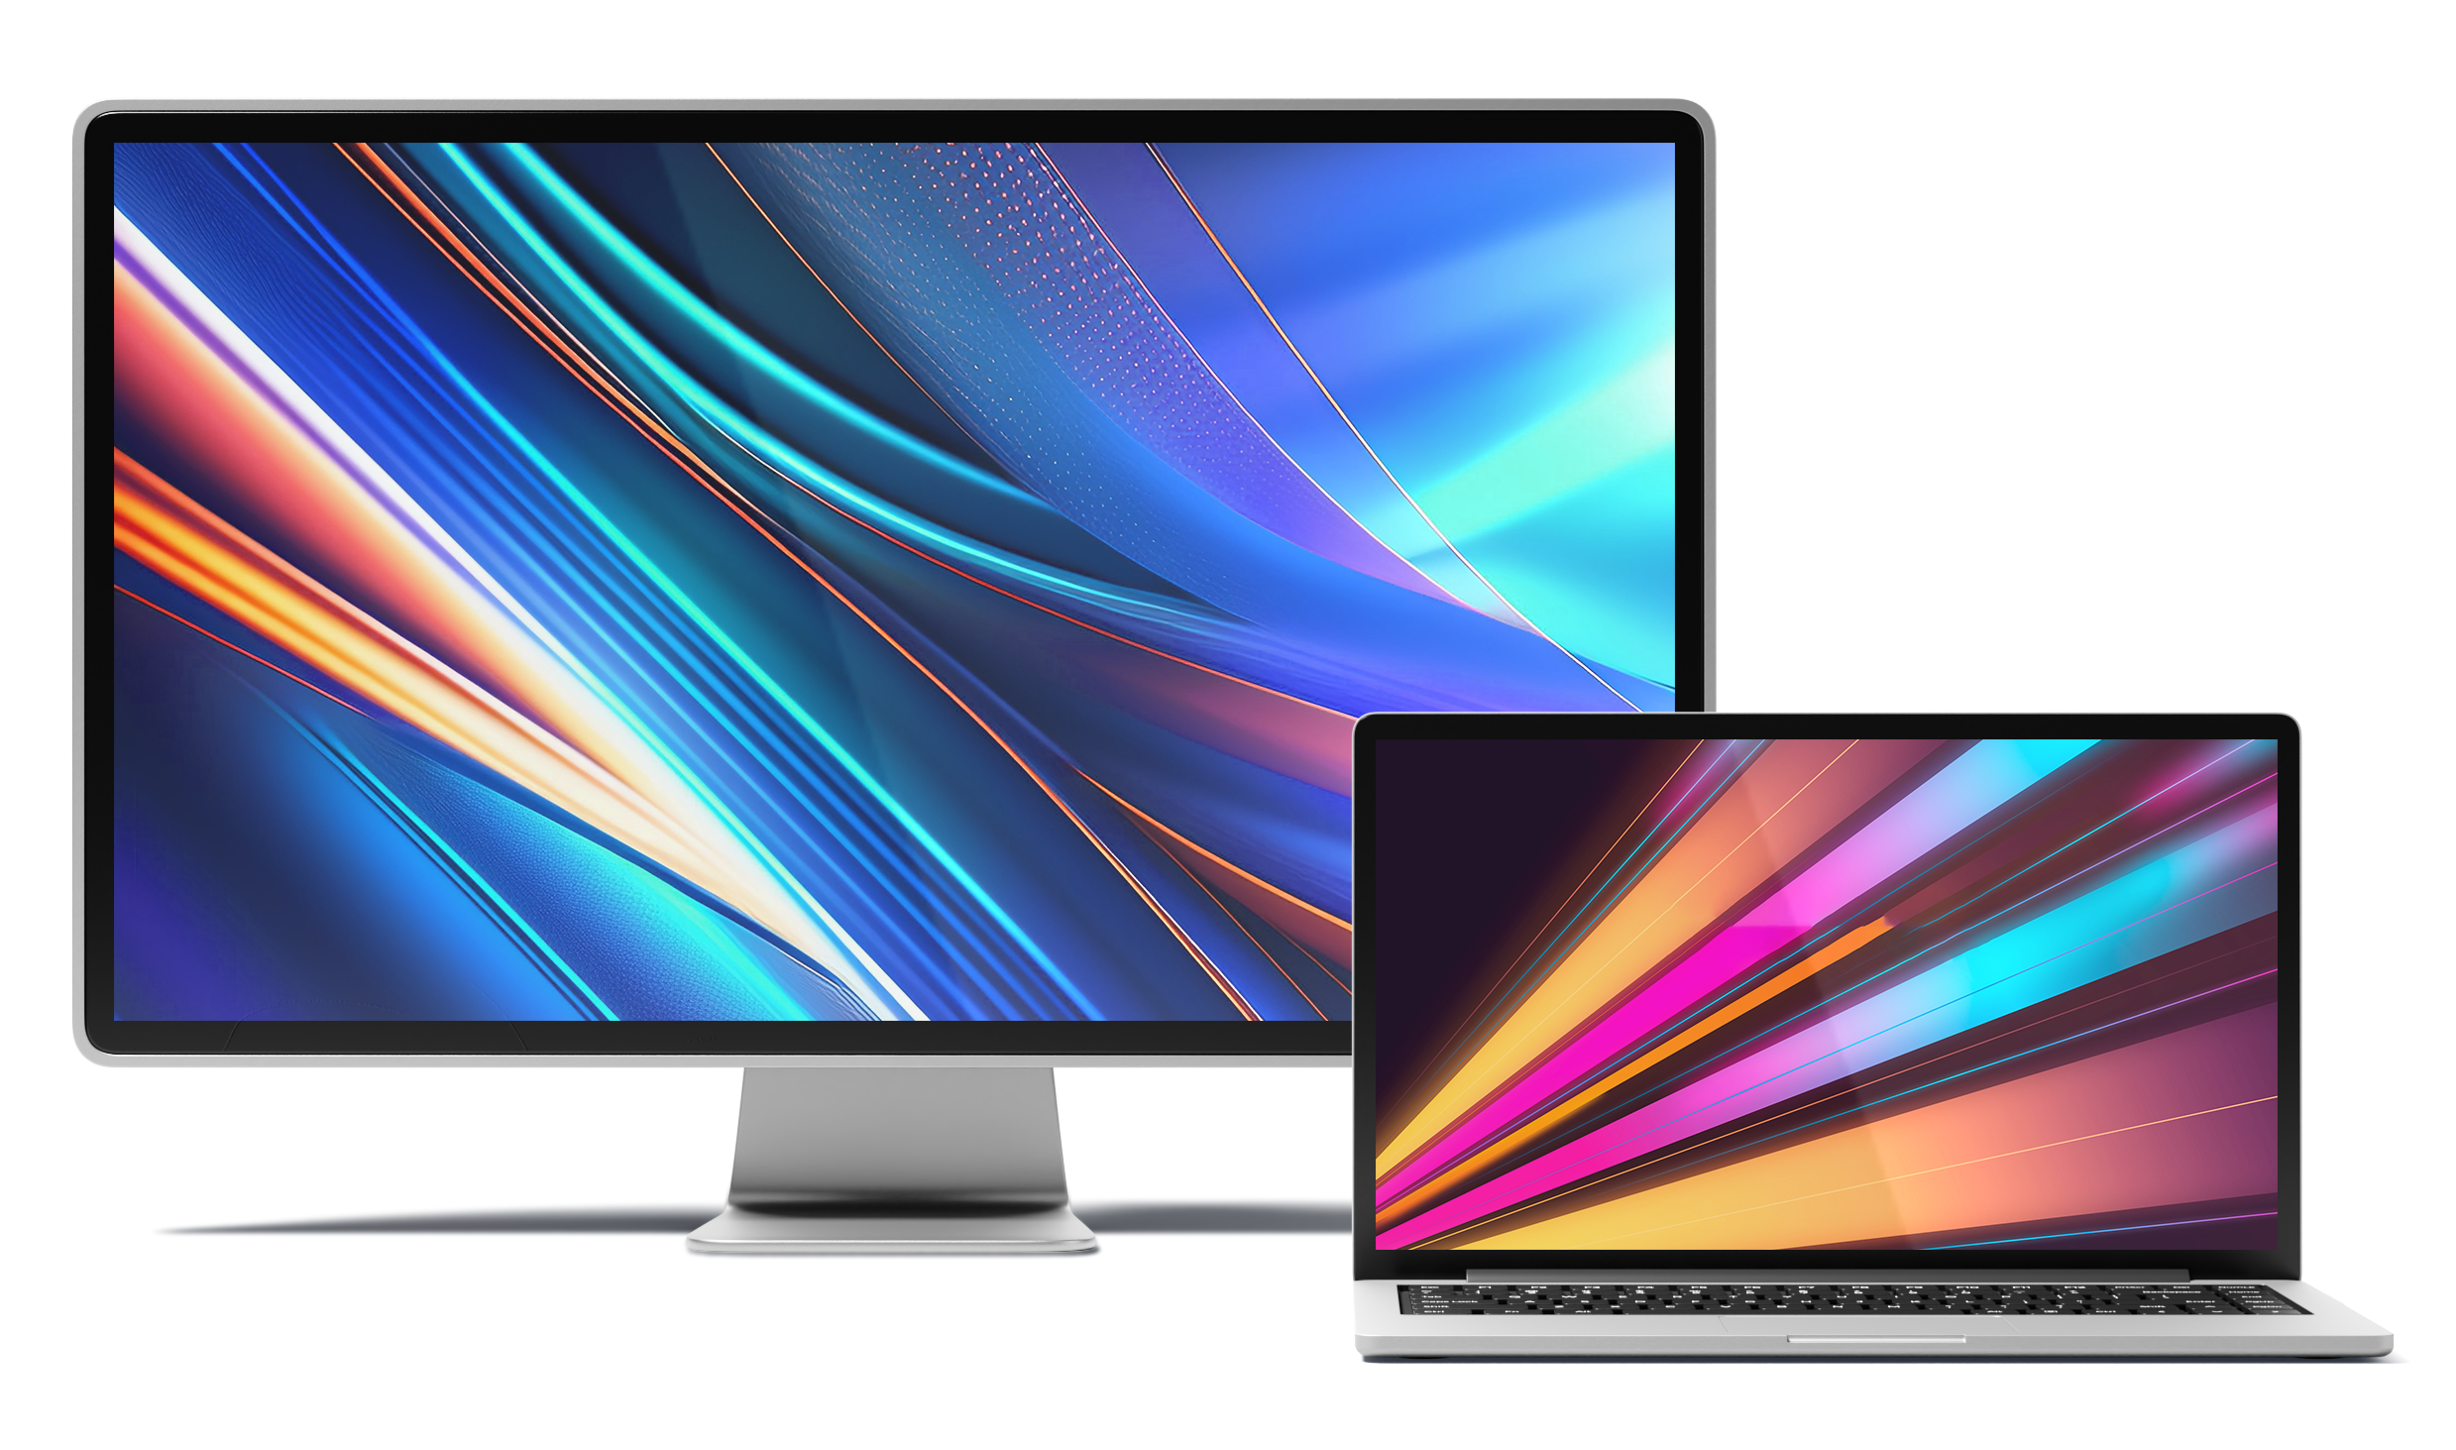
Max Display Resolution - Mac
MacBook | Maximum Resolution
All MacBooks with standard factory firmware | 3840 x 2160 @60Hz
M1/M2 & M1/M2 Pro & M1/M2 Max with special firmware | 3840 x 2160 @120Hz
M3/M4 & M3/M4 Pro & M3/M4 Max with special firmware | 3840 x 2160 @240Hz

Slide 8
Thanks!

